Slide 1
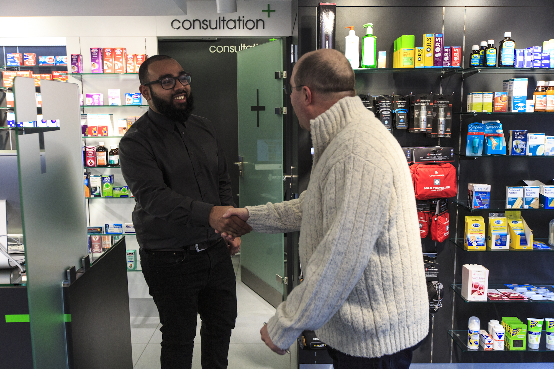


Community Pharmacy: Your local health partner
Trusted, accessible and embedded in local communities. Working together as part of your neighbourhood team.
1. The local lighthouse
Easy to access, close to home
Walk in for advice and support
See familiar healthcare professionals
Offer help when something doesn’t feel right
We are often the first stop for health concerns
2. We know our communities
We see patients and families regularly
We notice changes early e.g. medication adherence, social isolation
We understand local needs
We build trusted relationships
This helps us spot problems sooner
and offer the right support
3. Advice, education & signposting
We provide clear, simple health advice
We support patients to manage acute and long-term conditions
We provide help with medicines
We connect people to other support
We help people find the right help more easily
Why community pharmacy matters
Community pharmacies are:
On your doorstep
Often open longer hours than other services
No appointment needed
Staffed by people living in the community
A trusted first place to go
We help people stay well, get support early and connect to the right care
4. Prevention and early action
We help keep people well through: vaccinations; blood pressure checks; new medicine support; healthy lifestyle and self-care advice
We can reach less well served communities
Preventing illness reduces pressure on the wider system
5. Clinical care in the community
Delivering safe, patient-centred care
Highly trained pharmacy teams
Delivery of services such as: New Medicine Service (NMS); Hypertension case-finding; Pharmacy First
Improving medicines safety
We improve outcomes and reduce avoidable demand elsewhere
6. A willing and engaged partner
We are ready to:
Share insight and local knowledge
Work with GPs & community services
Align activity to neighbourhood priorities
Help reduce health inequalities
Community pharmacy wants to do more, together with other local partners
The Ask for Neighbourhoods
Include us as core partner
Enable communication & escalation routes
Use pharmacy insight to inform your plans
One neighbourhood, one team; better health for all.

