Slide 1



Smoke Free Nottinghamshire County in Primary Care
Presented by: Taseen Mannan and Kelly Hurd
Email: tmannan@ablhealth.co.uk
khurd@ablhealth.co.uk

Slide 2
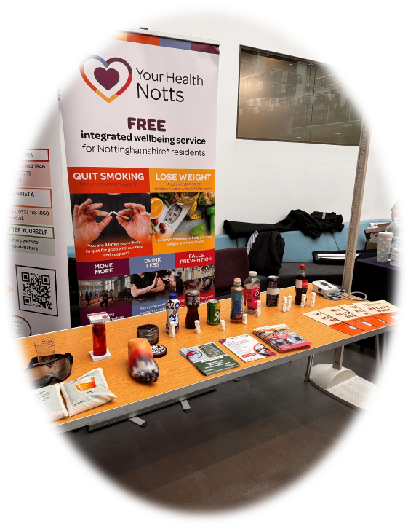
Who Are We?
We believe everyone has the right to good health.
We are committed to reducing health inequalities and promoting healthy behaviors through community-driven healthcare services.
Your Health Notts is commissioned by Nottinghamshire County Council.
Provide an Integrated Wellbeing Service for all residents of Nottinghamshire County
Range of different services including Weight Management (adult and families), Smoking Cessation, Physical Activity and Strength and Balance (Falls Prevention.

Slide 3
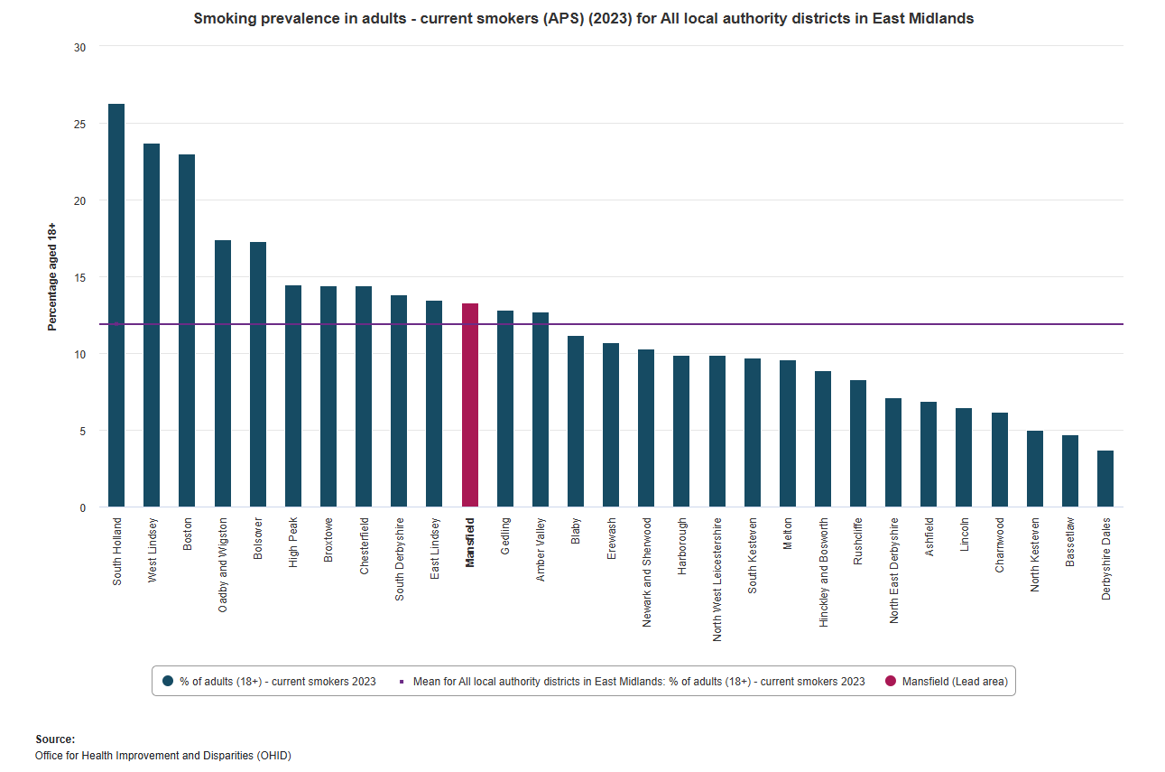
Smoking Prevalence in East Midlands

Slide 4
Smoke Free Delivery Level 2
Smoking cessation interventions led by trained Level 2 providers within pharmacy-based settings.
Competency framework to ensure provider readiness and service quality:
  Structured in-house training (NCSCT certified).
  Shadowing/reverse shadowing for experiential learning.
  Ongoing monitoring, mentorship, and quality assurance.
Regular, dedicated smoking cessation support sessions delivered face-to-face within pharmacies.
Focus on:
  Helping current smokers quit with tailored support plans and smoking cessation aids.
  Preventing young people from starting smoking through education and community engagement.
Cost-per-quit payment model for successful quit outcomes achieved within 4-12 weeks of the quit date set.

Slide 5
Benefits
Healthier Patients:
Focus on CO-verified quits to ensure reliable, measurable results.
Improved patient outcomes and reduced smoking prevalence.
Reduction in Costs:
Decreased healthcare costs due to fewer smoking-related illnesses.
Cost savings for pharmacies by reducing the burden of prevalent smokers.
Strengthening Community Health Role:
Pharmacies act as accessible, trusted health hubs within local communities.
Reinforces the pharmacy’s role in delivering preventative healthcare through specialised stop smoking training.
Additional Revenue Benefit:
Pharmacies receive reimbursements/service fees for delivering stop-smoking interventions.
Potential for new funding streams through successful service delivery.
Improved Quit Rates and Workforce Upskilling:
Combining in-person support with access to NRT significantly increases quit success.
Opportunity to train pharmacy staff to become NCSCT-certified Level 2 smoking cessation advisors.

Slide 6
Cost Payment Model
 | Model 1 | Model 2
Quit Type | Standard NRT- Reimbursed | Swap to Stop (S2S) ABL Vape kit Provided
4 week quit - CO Verified | £50 | £200
12 week quit - CO Verified | £20 | £50
12 week quit - Self reported | £10 | £20
Max Total Gain | £70* | £250
*Dispensing Admin Fee: £5 per session up to 8 per 12-week quit

Slide 7
Training Schedule Overview – Supporting Your Success
Comprehensive, Flexible Training Model
Fully accredited
Ongoing support and mentoring from our expert team
Flexibility around operational hours
Option 1: Full Training Programme (Approx. 15–17 hours)
Stage 1: NCSCT Core Knowledge - Self-paced (3.5–4.5 hours)
Stage 2: 3 x Live Teams Sessions (8.5 hours)
Covers smoking cessation foundations, pharmacotherapy, behavioural support, CO monitoring, and relapse management
Stage 3: Shadowing, Observations & Competency Assessment (3 hours)
Submit 2 x IA consultations (recorded or live) + optional sign-off session
Option 2: Condensed Training Pathway (Max. 14 hours).
Stage 1: NCSCT Core Knowledge - Self-paced (3.5–4 hours)
Stage 2: 3 x Streamlined Live Sessions (6.5 hours)
Merged content focusing on key clinical and practical skills
Stage 3: Abbreviated Observations & Sign-Off (2.5–3 hours)

Slide 8
How to Refer
into all the IWS Services
Referrals/ Self-referrals can be completed via:
Website https://yourhealthnotts.co.uk/sign-up/ or by calling our admin team on 0115 7722515.
Primary Care - Electronic referrals can be made via the F12 function on SystmOne or Ardens.
CYP: nottschildrenspoa.co.uk
Email to an NHS Inbox: yourhealth.notts@nhs.net
Referrals processed within 5 working days

Slide 9



Thank you
Any questions, please get in touch
tmannan@ablhealth.co.uk
07353 139 766 & 0115 772 2515
www.yourhealthnotts.co.uk
@yhnotts
Your Health Your Way Notts
Your Health Notts
@yhnotts

