Slide 1
Hypertension Quality Improvement Resource - Visual Summary
Winter 2021
A set of tools and resources put together by East Midlands Cardiovascular disease prevention network to help ensure best practice
Notes:
The T&F Group agreed that we wanted the resource to be:
Succinct and visual– with extra information added to slide notes for those who are interested and further signposting.
To encourage PCNs and ICSs to explore their own data, to support them in recovery, improving targeting, optimising and prioritising.
To present a multi-agency, coherent, collaborative approach
Implementation – a support offer for implementation, not just provision of information

Slide 2
Welcome
This resource includes:
Local data tools for exploring your current position with the national ambitions for hypertension in comparison to others at practice and ICS/STP level.
Good practice examples to support improvement in CVD prevention and outcomes in primary care.
Workforce development and support
This resource is for those working in PCNs and ICSs to use, to improve CVD prevention and meet the PCN CVD DES for hypertension. It looks to reduce the gap between observed versus expected numbers of hypertension cases whilst considering the inequalities that exist in CVD prevalence, risk factors and those who come through optimal care.
Slide | Contents
3 6-8 | National, regional and local data – how to use and inform action: BHF Hypertension infographic CVD prevention packs - visual demonstration
10 | Support for Health care quality improvement: Hypertension case finding service NICE quality standard CVD Prevent UCL partners proactive care frameworks Core20PLUS5
12 | Good practice examples
14-15 | Workforce development and support
Notes:
The introductory slide demonstrates the multi-agency approach taken, explains the aims of the resource and how we envisage it being used. A clear contents table is visible as some may only be interested in aspects of the resource (support for quality improvement)

Slide 3
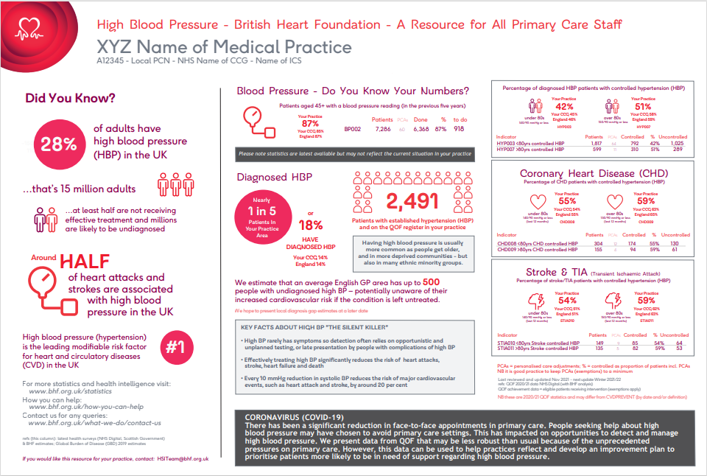
BHF - practice level data on hypertension
Use this to know your numbers at practice level in comparison to your CCG and England
For your local practice data, please contact:
HSITeam@bhf.org.uk
Notes:
It provides data for practices to help with understanding the size of the problem locally, and comparison with average performance being achieved by CCG and England.

Slide 4
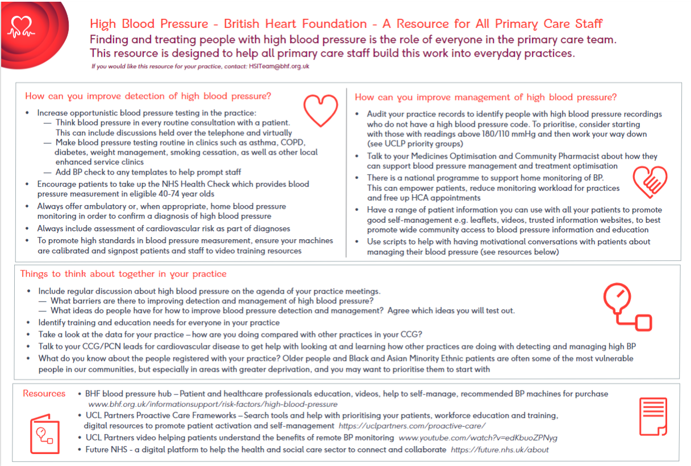
Includes prompts and easy steps that practice staff can take to improve detection and management
For your local practice data please contact:
HSITeam@bhf.org.uk
Notes:
It also includes some simple prompts to help with thinking about easy steps that practice staff can take to improve detection and management.

Slide 5
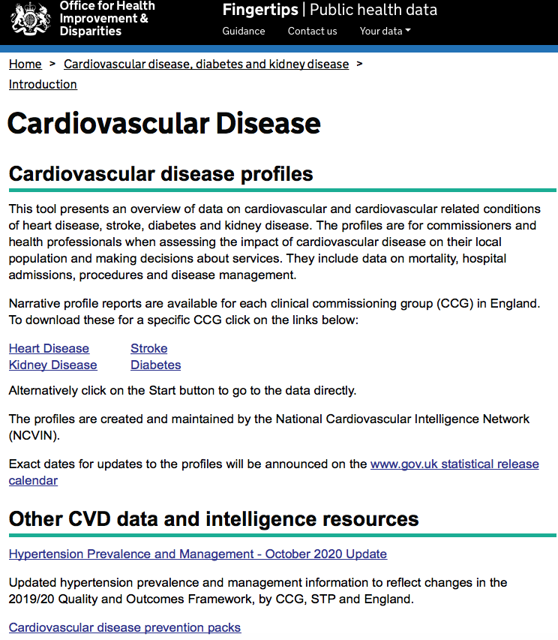
National cardiovascular disease prevention packs
Developed by National Cardiovascular Intelligence Network (NCVIN) as means of supporting the implementation of the national ambitions on the diagnosis and treatment of hypertension, by showing opportunities in CVD prevention.
There are packs available for:
Each ICS/ STP, reporting: ICS/STP, CCG, PCN and practice level information if requested. The packs also contain information on risk factors and NHS Health checks in addition to diagnosis and treatment of Hypertension and AF
How to use the packs – packs show:
How well you are doing in detecting and treating hypertension
Your biggest opportunity for improvement
Your variation
Visual examples of the graphs included in the packs follow on the next 3 slides
*Please note the packs contain 2019/20 information and therefore represent a primary care pre-pandemic baseline
Notes:
Aims to illustrate:
Variation in diagnosis and care
Estimate or quantify the number of people required to be diagnosed or treated to meet the ambitions
Identify good practice or areas for quality improvement

Slide 6
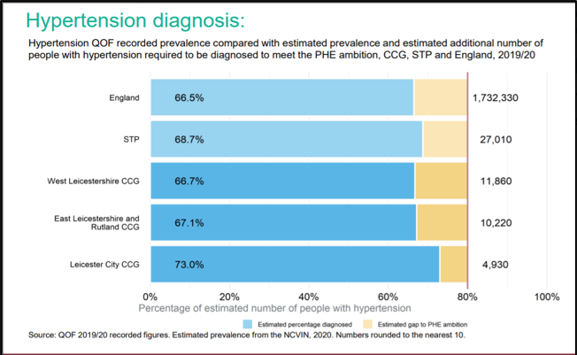
Example 1: Are all people we expect to have hypertension diagnosed?
All packs provide hypertension detection and treatment data. This is an example STP pack showing for each CCG the number of people to diagnose to meet the national ambition
% of expected number diagnosed
Illustrates variation in diagnosis
Estimated number required to be diagnosed to meet the national ambition
Identifies good practice or areas for quality improvement
% left to diagnose
to meet ambition
Number of people
to diagnose to
meet ambition
Hypertension
diagnosis ambition
Notes:
All packs provide hypertension detection and treatment data. This is an example STP pack showing for each CCG the number of people to diagnose to meet the national ambition.
*Please note the packs contain 2019/20 information and therefore represent a primary care pre-pandemic baseline

Slide 7
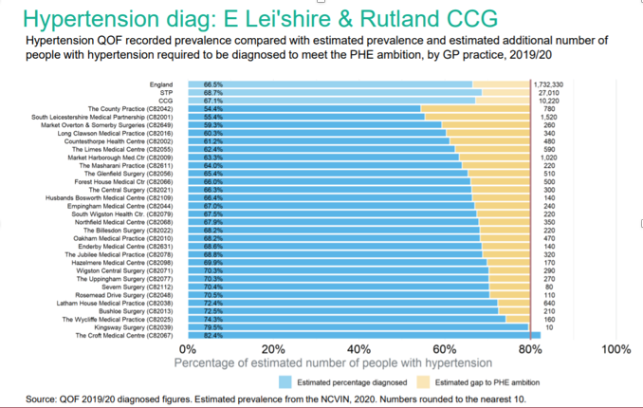
Example 2: Hypertension diagnosis at GP level
There’s also the ability to view the data at practice level – here illustrating large within CCG variation.
Data available at practice level
High numbers at
GP level
Within
CCG
variation
Notes:
There is the ability to view the data at practice level – here illustrating large within CCG variation.
*Please note the packs contain 2019/20 information and therefore represent a primary care pre-pandemic baseline

Slide 8
Example 3: Within ICS/STP variation
Large variation within ICS/STP at practice level
Variation across an ICS/STP
At GP level ICS/STP range: 55.6% to 100%
Notes:
There is the ability to view practice level variation across an ICS
*Please note the packs contain 2019/20 information and therefore represent a primary care pre-pandemic baseline

Slide 9
SUPPORT FOR Health care QUALITY IMPROVEMENT
Hypertension case finding service
NICE Hypertension in adults quality standard (QS28)
CVD Prevent
UCL partners proactive care frameworks
Core20PLUS5

Slide 10
Support for quality improvement
Resource | Description
Hypertension case finding service | For Pharmacies, GP practices and appliance contractors, this is the specification for how to put in a case finding service. Specifications are listed as part of the year 3 community pharmacy contractual framework service to assist in hypertension case-finding.
NICE Hypertension in adults quality standard (QS28) | This NICE quality standard describes high quality care in priority areas for improvement. It contains evidence based statements aligned to PCN CVD DES and quality measures associated with these, for: structure, process and outcomes.
CVD Prevent | Is a national primary care audit that extracts routinely held GP data (such as hypertension diagnosis and management) and aims to support professionally-led quality improvement by highlighting variation in identification, diagnosis, and management of people at risk of CVD against metrics of deprivation, age, sex, and ethnicity.
UCL partners proactive care frameworks | Allows patients on a hypertension register to be risk stratified and prioritised for intervention. Includes comprehensive search tools which run on GP IT systems (EMISand SystmOne). Slide packs include pathways and resources to support clinicians treating patients with single or multiple cardiovascular conditions including hypertension.
Core20PLUS5 | A national NHS England and NHS Improvement approach to support the reduction of health inequalities at both national and system level. The approach defines a target population cohort – the ‘Core20PLUS’ – and identifies ‘5’ focus clinical areas requiring accelerated improvement including Hypertension case-finding: to allow for interventions to optimise blood pressure and minimise the risk of myocardial infarction and stroke.
Notes:
NICE Quality standards (QS) are a set of prioritised statements, which highlight areas where we know there is great variation in practice and opportunity for improvement. QS are derived from the guideline.
Statement 1People with suspected hypertension are offered ambulatory blood pressure monitoring (ABPM) to confirm a diagnosis of hypertension.
Statement 2 People with newly diagnosed hypertension receive investigations for target organ damage within 1 month of diagnosis.
Statement 3 This statement has been replaced by quality statements on primary and secondary prevention of cardiovascular disease in NICE's quality standard for cardiovascular disease risk assessment and lipid modification.
Statement 4 People with treated hypertension have a clinic blood pressure target set to below 140/90 mmHg if aged under 80 years, or below 150/90 mmHg if aged 80 years and over.
Statement 5 People with hypertension are offered a review of risk factors for cardiovascular disease annually.
Statement 6 People with resistant hypertension who are receiving 4 antihypertensive drugs and whose blood pressure remains uncontrolled are referred for specialist assessment.
Each quality statement is accompanied by a measure, which can be used to track progress of improvement projects and feed into local quality dashboards.
Equality and diversity considerations
Statement 1
ABPM may not be suitable for everyone, for example people with particular learning or physical disabilities. Some people may be unable to tolerate ABPM and some people may decline it.
Home blood pressure monitoring (HBPM) should be offered as an alternative to ABPM in such cases, in line with NICE's guideline on hypertension in adults, recommendation 1.2.4. If a person is unable to tolerate ABPM, HBPM is a suitable alternative to confirm the diagnosis of hypertension.
Statement 3
Targets are based on evidence of safe practice. A person aged 80 years or over with treated hypertension would not have a target clinic blood pressure of 150/90 mmHg if their blood pressure was already treated to below this threshold. Healthcare professionals should use clinical judgement when agreeing blood pressure targets with people with frailty or multimorbidity.

Slide 11
good practice examples

Slide 12
Good practice examples
Intervention | Practice example | What was done
GP code cleansing to ensure accuracy of numbers | GP data cleansing initiative for atrial fibrillation and hypertension in Hampshire, Isle of Wight and Thames Valley regions | Specified search criterion of the patients’ medical records to identify those receiving treatment for HTN and AF, but who did not currently have a clinical code and reviewed patients with persistently high blood pressure readings without a problem code. 12,700+ patients added to hypertension registers as a result.
Systematic case finding of people with hypertension | Systematic case finding of people with hypertension – East Berkshire | The CCG Medicines Optimisation Team used systematic audit to support practices in finding people who either had hypertension or were at risk of developing hypertension. Pharmacists added people to disease registers or referred people not yet diagnosed for diagnosis, increasing the register by over 6,000 and providing a model for future working.
Virtual clinics to improve BP in poorly controlled patients | Virtual clinics to improve BP in poorly controlled patients | Lambeth clinical commissioning group (CCG) developed a programme of virtual clinics focused on reviewing a group of patients with uncontrolled high blood pressure, resulting in a significant reduction in individual BP recordings.
Pharmacist Led Hypertension Review Project in Black (African or African-Caribbean origin) Patients | Pharmacist led hypertension review project in Black (African and African-Caribbean origin) patients - Hackney CCG | Pharmacists were trained to undertake a person-centred consultation and hypertension review clinics in practice. Designed a protocol (covering BP target, med choice, med adherence and lifestyle advice), underpinned by NICE, and invited patients for a review and a follow up. Results showed uptake in lifestyle interventions, reduction in BP and increased medication adherence.
A quality improvement package for high BP management in general practice | A quality improvement package for high blood pressure (BP) management in general practice, part of a systems leadership approach to tackling high BP in Cheshire and Merseyside | Created EMIS Web-based consultation templates for new and existing patients, ‘gold standard’ practice protocol, practice-level data dashboard/ audit tool, patient information prescription and training resulting in increased performance against NICE standards.

Slide 13
Workforce development and support

Slide 14
Workforce development
Resource | Description
Motivational interviewing (Health Education England) | Presents ideas for GPs on how to use motivational interviewing to encourage behaviour change in patients.
NICE Clinical Knowledge Summaries (CKS) | Provides primary care practitioners with a readily accessible summary of the current evidence base and practical guidance on best practice. Over 370 topics organized alphabetically, with focus on the most common and significant presentations in primary care including hypertension.
MECC website resources | A range of e-Learning resources which provide the underpinning knowledge to support the delivery of very brief or brief interventions. Includes NICE guidance documents on behaviour change, helping to support the implementation and delivery of MECC programmes.
e-learning for healthcare – NHS Health check | Online learning for training in the knowledge and resources underpinning the activities associated with conducting an effective NHS Health Check. Aimed at health trainers, pharmacy staff, and health care assistants.
HEE hypertension e-learning modules and All Our Health | Incorporates up to date guidelines and evidence-based aims specifically addressing the needs of GPs, community pharmacists and other clinical staff working in GP practices, in the diagnosis and management of hypertension and cardiovascular disease (CVD) risk.
Getting to grips with the PCN dashboard On-line training sessions 16/02/22 | This two-hour session is aimed at PCN business managers and clinical directors and goes through the dashboard section by section so delegates are familiar with the data that is available and how to make best use of it.

Slide 15
Support
Resource | Description
Hypertension QI resource pack on FutureNHS | A comprehensive quality improvement resource to support PCNs and practices understand their data and processes in respect of hypertension and a process guide to implementing change.
Blood Pressure @home workspace on FutureNHS | Implementation support to CCG and regional colleagues who are coordinating the blood pressure @home programme.
Join the discussion on FutureNHS | General discussion forum from the Cardiac Pathways Improvement Programme
For more information please contact:
Sue Gowton, Network quality improvement co-ordinator, Midlands CVDR Clinical Network England.cvdnetwork1@nhs.net

