Slide 2
CPPE Hypertension resources
Emma Anderson

Slide 3
Hypertension Gateway page
This contains links to key external resources as well as the CPPE hypertension workshop and other CPPE programmes.

Slide 4
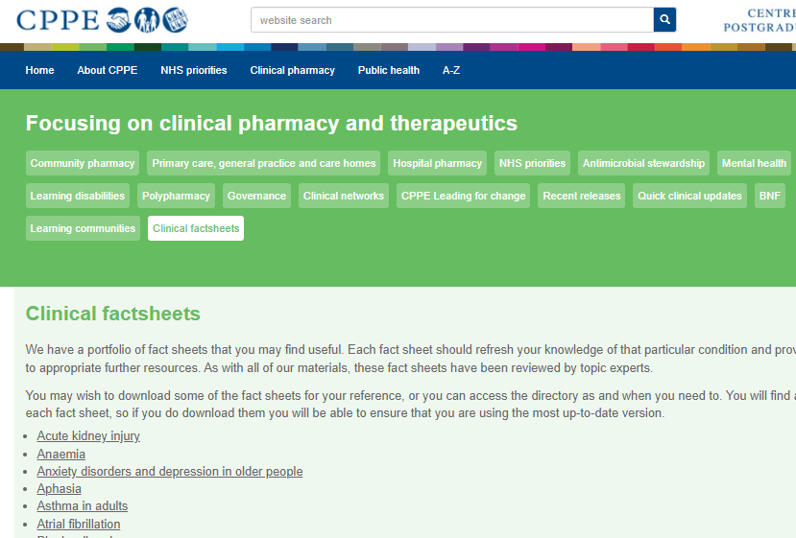
Clinical factsheets
CPPE has a range of clinical factsheets on topics from glaucoma, to osteoporosis including hypertension.
Go straight to the section that you need.
Notes:
CPPE has a range of clinical factsheets on topics from glaucoma, to osteoporosis and also hypertension.

Slide 5
Patient support
The hypertension factsheet contains links to the following patient support
https://www.bhf.org.uk/informationsupport/risk-factors/high-blood-pressure
https://www.bloodpressureuk.org/
https://www.nhs.uk/conditions/high-blood-pressure-hypertension/

Slide 6
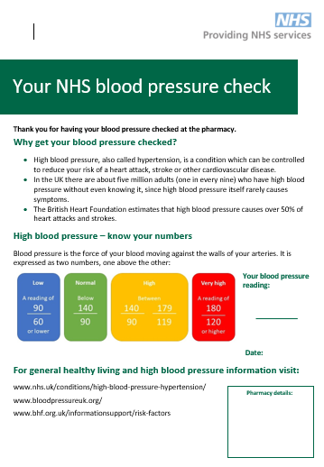
PSNC resources
Service pathway
Patient leaflet to support provision of readings
Posters
Recording documents
https://psnc.org.uk/services-commissioning/advanced-services/hypertension-case-finding-service/
Notes:
Run poll

Slide 7
Hypertension workshop
A multisector event, that gives you a patient journey. This event will support the provision of hypertension case-finding and the New Medicine Service for hypertension medicines. It will also support you to see how pharmacy professionals in other sectors work.

Slide 8
CPPE Community Pharmacist Consultation Service CPCS resources
Emma Anderson

Slide 9
NHS CPCS essential skills
The aim of the programme is to support you to develop the knowledge, skills and confidence needed to undertake effective consultations, communications and clinical assessments in order to provide the NHS CPCS.
The programme is made up of two components: a self-directed e-course and a series of two interactive workshops (hosted by RPS/RCGP). You must complete both components (the e-course and attend the online workshop(s)) to meet the learning objectives below.

Slide 10
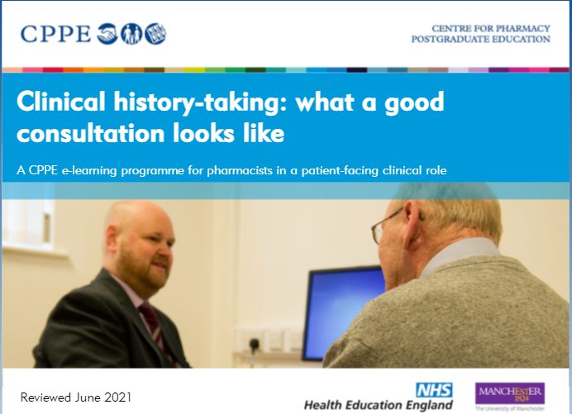
Clinical history taking – smart use of time
Lets, have a quiz, see if you can remember what each letter in
SOCRATES
Stands for
Points = prizes!
Notes:
Clinical history taking is another way to use your time in consultations smartly. You don’t want arduously long consultations, patients don’t like to be asked unnecessary questions. Effective clinical history taking makes consultations efficient, safe and high quality.
Interactive quiz – what do each of the letters stand for?
A chocolate for correct answers!
S = Site
O= Onset – medication or vaccine side-effects could be ruled out by onset informaion
R = Radiation, could indicate neuro involvement in pain or and infection spreading
A = Associated symptoms,
T = Time/duration – i.e. getting better or worse over time or at different times of day
E= Exacerbating or relieving factors. I.e. joint stiffness that is worse in the morning and better relieved by hot or cold = sign of arthritis
S= Severity, are the symptoms stopping you from doing anything or causing night time waking

Slide 11
Clinical history
Notes:
Other things that are really important to get through consultations rapidly and safety are;
Hello my name is Emma, I am a pharmacist
Do you have any questions about this? Safety netting – if you are giving some information in written form, due to time restrictions, it’s really important to discuss what the patient should do if things to do go to plan.

Slide 12
Consultation skills are everything
If you have short consultation times consultation skills are everything.
Notes:
Effective consultations skills are necessary to make smart use of time. If you only have a short time, you need to build an rapport with the patient quickly.
Consultation skills what good practice looks like is a 2.5 hour programme if you do absolutely everything. My colleague, mentor and friend Barry Jubraj works with the amazing Nina Barnett, James Desborough and Reena Barai and award winning community pharmacist to show you hints and tips to give quality as well as efficient consultations.
People think that good quality services means not seeing many patients, our experience at Castle Donington shows that you can provide a high quality service that people will recommend to their friends and family without compromising on volume.

Slide 13
Any questions?

Slide 14
www.cppe.ac.uk
info@cppe.ac.uk
0161 778 4000
Follow us on Twitter, Facebook, LinkedIn and YouTube:
www.twitter.com/cppeengland
www.facebook.com/cppeengland
www.linkedin.com/company/centre-for-pharmacy-postgraduate-education
www.cppe.ac.uk/youtube

