Slide 1



The New GPhC Inspection Model
Leyla Hannbeck,
Head of Pharmacy Services, NPA

Slide 2
The new inspection model
“A show me, tell me story”
Governance arrangements
Empowered and competent staff
Managing pharmacy premises
Delivering pharmacy services
Equipment and facilities
Based on FIVE principles and the underpinning GPhC standards

Slide 3


Principle 1: Governance arrangements
This is all about managing the potential risks that processes and services may pose to patients/public
  Standard operating procedures (SOPs)
  Staff have clear roles
  Complaints procedure
  Appropriate records
  Safeguarding Children and vulnerable adults
NPA standard operating procedure
NHS Complaints
Record Book

Slide 4

Principle 2: Empowered and competent staff
This is all about the competency of staff, the skill mix and the way that training is managed within the pharmacy
Sufficient staff with appropriate skill mix
Training is appropriately supervised
Culture of openness, honesty and learning
Incentives/targets should not affect patient care
This is to certify that:

Slide 5



Principle 3: Managing pharmacy premises
This is all about having well-maintained pharmacy premises that are hygienic, well-designed and secure
Well-maintained and safe pharmacy premises
Compliant with the Health Act
Clean and hygienic
Secure

Slide 6


Principle 4: Delivering pharmacy services
This is all about the promotion and accessibility of pharmacy services to the public, and ensuring safe delivery of these
Clearly displayed pharmacy services
Promotion of healthy lifestyles
Stock is sourced, stored, supplied and disposed of appropriately
Services benefiting local community

Slide 7



Principle 5: Equipment and facilities
This is all about ensuring that equipment and facilities used in the pharmacy are safe and for for purpose
Well-maintained equipment is available
Equipment is fit for purpose and to the appropriate safety standard
IT equipment protects confidentiality
Notes:
Availability of equipment
-up-to-date reference sources, dispensing equipment (including CE marked glass measures, counting triangles etc)
From a reputable source
Safe and fit for purpose
-regular maintenance and cleaning, with records kept, correct storage (electrical equipment away from water for example), clean, safe seating in waiting area
Stored securely with prevention of unauthorised access
-correct storage of sharps, IT equipment stored securely, IG SOPs and toolkit, passwords (different access levels; changed regularly)
Maintained appropriately
Reputable company that services equipment; business continuity arrangements; cleaning procedures and evidence of
Protection of patients dignity and privacy
-IG procedures in place – IG SOPs, toolkit; disposal of confidential waste; PMR/IT equipment password protected, computer screen hidden from unauthorised access, mobile IT equipment eg laptops used securely, safe storage of paper records (including Rxs)

Slide 8

“A show me, tell me story” by the NPA
Video clips for pharmacists and their teams on NPA Website!
Principles
Evidence
In practice scenarios
Sign-posting
How am I doing?
Notes:
For each of the five principles and underpinning standards that pharmacies need to comply with, a resource has been produced by NPA Pharmacy Services that includes the following:
-Definition of the GPhC principle and an outline of its meaning
-Evidence — suggestions that may assist in complying with the principle and its underpinning standards; compliance with standards may also be achieved in other ways
-In practice — scenarios which the pharmacy team can discuss to establish whether processes are in place and being adhered to
-Signposting to resources that will assist in meeting the standards
-How am I doing? An opportunity for pharmacy owners/superintendent pharmacists to carry out their own grading and determine areas that may require action to ensure that the inspection is successful
This toolkit has been designed to provide pharmacy owners/superintendent pharmacists with the opportunity to assess procedures within their pharmacy/pharmacies and take any action necessary so that they are operating not only in line with standards and best practices, but pro-actively striving for improvements in standards. The resources can also be used as a continual form of assessment so that processes and procedures in the pharmacy are constantly reviewed and any necessary action taken.

Slide 9
Summary of NPA resources:
The following resources are available in this series, with further documents planned in due course:
“GPhC inspections “A show me, tell me story”: introduction”
“GPhC inspections “A show me, tell me story”: Guidance — Principle 1”
“GPhC inspections “A show me, tell me story”: Guidance — Principle 2”
“GPhC inspections “A show me, tell me story”: Guidance — Principle 3”
“GPhC inspections “A show me, tell me story”: Guidance — Principle 4”
“GPhC inspections “A show me, tell me story”: Guidance — Principle 5”
“GPhC inspections: “A show me, tell me story”: Self-assessment grading”
“GPhC Inspections: FAQs (Dec 2013)”
“GPhC inspections: NHS public health campaign pharmacy log”
“GPhC inspections: Pharmacy cleaning matrix”
“GPhC inspections: Pharmacy date-checking matrix”
“GPhC inspections: Pharmacy drug/device alert log”
“GPhC inspections: Pharmacy maintenance issues log”
“GPhC inspections: Recommended resources”
“GPhC inspections: Pharmacy self care log”
“GPhC inspections: Pharmacy signposting record log”
“GPhC inspections: Pharmacy team training record” (for individual members of the pharmacy team)
“GPhC inspections: Sale of medicines protocol guidance”
Other NPA resources:
Standard operating procedures:
o Controlled Drugs
o Responsible pharmacist
o National Patient Safety Agency (for example, supplying insulin, supply of lithium therapy)
o Medicines Use Review

Slide 10

How do inspectors grade pharmacies?
Poor
Excellent!!
Our aim = NPA members
Satisfactory
Good

Slide 11
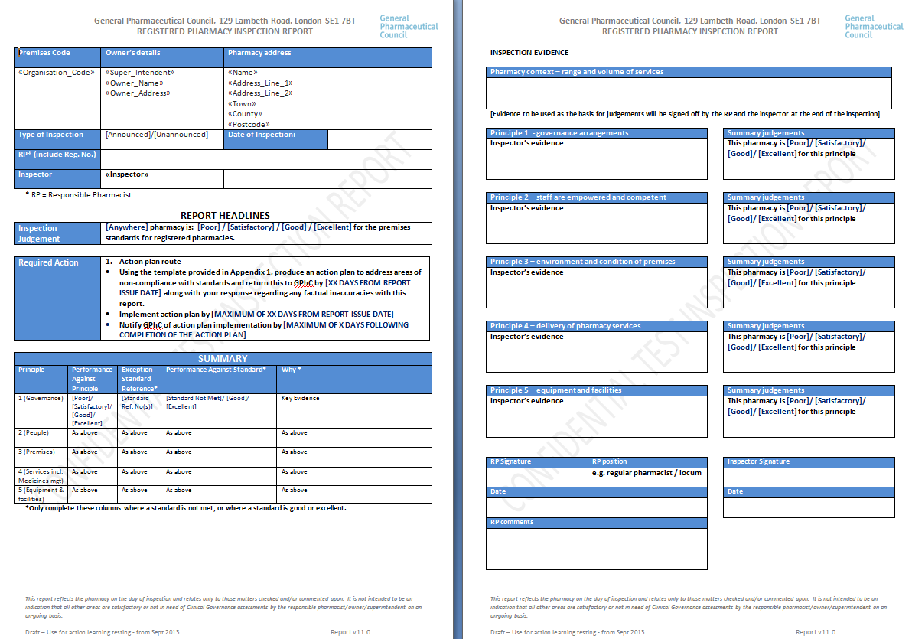

Slide 12
What if my pharmacy receives a poor* judgement?
Moderate or high risk to patient safety:
Rectify within TEN working days
Action plan issued
Superintendent pharmacist to respond within two days
No significant risk (ie satisfactory but some standards not met)
Rectify within TWENTY working days

Slide 13

Scenario 1
Dispensing error: Tegretol Prolonged Release tablets 200mg supplied instead of Voltarol Retard tablets.
The patient took the tablets for two days before the error was detected and the patient’s doctor has contacted the pharmacy to notify the pharmacist of the error. The dispensing technician takes the call — what action would they take?
HC11
NHS
Help with health costs
Which member of the pharmacy team were involved?
How are incidents dealt with?
What processes are in place to notify the patient?
Are incident reporting procedures in place?
What possible factors were implicated in the incident?
Is indemnity insurance cover in place?

Slide 14

Scenario 2
You overhear a conversation on the chemist counter in which a member of the pharmacy counter staff is selling chloramphenicol eye drops 0.5% for use in a dog.
You intervene in the sale and afterwards take the member of staff to one side; how do you ensure that this does not happen again?.
What training has the member of staff completed?
How often is staff training planned and is this recorded?
Are one-to-one meetings planned in?
Is there a Sale of Medicines Protocol in place and do staff adhere to it?

Slide 15

Scenario 3
You are checking the uncollected owing prescriptions and notice that a number of prescriptions are nearing their expiry date.
Some of these are long term out-of-stock items and you are unsure whether the items are still required. In addition, two of the bags on the shelf contain fridge lines.
Audit to determine the percentage of owing items against the total items dispensed
Review the frequency of checking owing items and which member(s) of staff are responsible — confirm that there is a checking matrix
SOPs on supply of medicines — dealing with fridge lines, Controlled Drugs, owing items and so on; stickers should be used to highlight prescriptions containing these items

Slide 16
Scenario 4
How can you be sure that the medicines you sell/ supply are in date?
There is a data checking matrix in place and staff know how it operates
That stock approaching expiry data is clearly marked to differentiate from in-date stock
That procedures are in place for dealing with out-of-date medicines
That you have a SOP in place on how to store medicines
In this scenario staff will need to demonstrate that Principle 1 and 2 are complied with

Slide 17

FAQs: general
Will I get a notification of the intention of a GPhC inspectors visit?
If there is a locum pharmacist on duty, can the inspection be deferred?
Notes:
Will I get a notification of the intention of a GPhC inspectors visit?
During the prototype phase, some pharmacies will receive notice that a GPhC inspection will occur during the following six weeks whilst other pharmacies will not receive any notice. This is to assist the GPhC in determining whether or not it is appropriate to give notice of a GPhC inspection once the prototype phase has finished. Once the prototype phase has ended the GPhC will confirm whether future inspection visits will be notified or unannounced.
If there is a locum pharmacist on duty, can the inspection be deferred?
No. Even if the RP on duty is a locum pharmacist, the inspection will still proceed. Locums should be able to operate in line with pharmacy procedures to ensure that patient safety is not compromised. The whole pharmacy team should be involved in the inspections, and be able to demonstrate how processes work, not just the pharmacist
Pharmacy teams should be able to demonstrate that processes are in place every day, as incidents, queries, discrepancies and so on are all part of the possible day-to-day scenarios that may occur in any one pharmacy

Slide 18
FAQs: action plans
What if the Superintendent Pharmacist is on holiday and an action plan needs to be produced?
I am not sure that ten days is sufficient time to rectify the shortfalls, what can I do?

Slide 19

FAQs
How often will my pharmacy be visited?
Are the visits similar to the contract monitoring visits?
There is some overlap
GPhC inspections focus heavily on patient safety; risk assessment forms part of Clinical Governance (an NHS Essential Service)
Contract monitoring visits are carried out by Local Area Teams, and only apply to those pharmacies in NHS England’s pharmaceutical lists; GPhC inspections apply to all registered pharmacies
Notes:
The GPhC has not specified this although pharmacies that pose a greater risk to patient safety will be visited more frequently
The NPA advises Superintendent Pharmacists to be prepared for an inspection at any time
Contract monitoring visits are carried out by Local Area Teams (LATs) to ensure that pharmacies are providing Essential and Advanced Services to the required standard and are complying with their contractual NHS requirements. Only those pharmacies that appear in NHS England’s pharmaceutical lists are required to undergo contract monitoring visits.
All registered pharmacy premises are subject to GPhC inspections, irrespective of whether or not they have an NHS contract.
Previously, each pharmacy was visited every three–to–five years. Now, pharmacies that pose greater concerns with respect to patient safety in particular will be visited more frequently.
There is some overlap between the two types of visits. Clinical Governance, an Essential Service that is monitored by LATs, includes a risk management programme; the new GPhC inspections focus heavily on patient safety and how the pharmacy is ensuring that risks to patients are minimised.

Slide 20
Remember!
The focus of the inspections is patient safety
Inspectors are not looking to penalise minor issues
It does not matter what methods are used to achieve standards
The more prepared you are, the less time the inspection will take
The NPA Pharmacy Services Support and toolkits
Notes:
To help pharmacies prepare for an inspection, the NPA toolkit and self-assessment grading tool can be used:
The NPA Pharmacy Services toolkit “GPhC inspections: “A show me, tell me story”” includes a “How am I doing?” section for each principle, which should be used in conjunction with the “GPhC inspections “A show me, tell me story”: Self-assessment grading” tool. Pharmacy owners/superintendent pharmacists are invited to inspect their pharmacy from the inspector’s perspective and/or from the patient’s perspective. All processes that take place within the pharmacy should be reviewed to see how patients are accommodated, or how services are provided safely. There may be instances where the pharmacy does not provide the exact example detailed in the guidance, but is still able to accommodate patients.
For example, an induction (hearing) loop may not be available in the pharmacy but a member of the pharmacy team may be able to use sign language (although consideration would have to be given to provision for when that person was not available in the pharmacy).
Remember to let the inspector know of successes in your pharmacy! Talk to the pharmacy team about successes that you have had.
GPhC inspectors may ask what achievements the pharmacy team are proud of with regards to the services that are provided from the pharmacy. The pharmacy team should be able to describe their successes, how these were identified and what action was taken to either implement a new service or make an improvement to an existing one.

Slide 21


Any questions?
GPhC inspections: Pharmacy log
Record keeping
Legal records maintained
Logs/matrices maintained as supporting evidence
NPA standard operating procedure
SOPs:
In place for all the processes in the pharmacy
Up to date and regularly reviewed
Staff can demonstrate that processes are followed in line with SOPs
Evidence of where incidents have occurred and SOPs reviewed, thus improving processes

Slide 22

The end!
Thank you for listening and good luck!!
Email: l.hannbeck@npa.co.uk
Twitter: LeylaHannbeck

